Slide 1
Questioning Images

Slide 2
Starter
Notes:
Key questions:
What does the image show?
How does it make you feel?
How would you describe the meaning of the image?
Do you think others could interpret the message differently

Slide 3
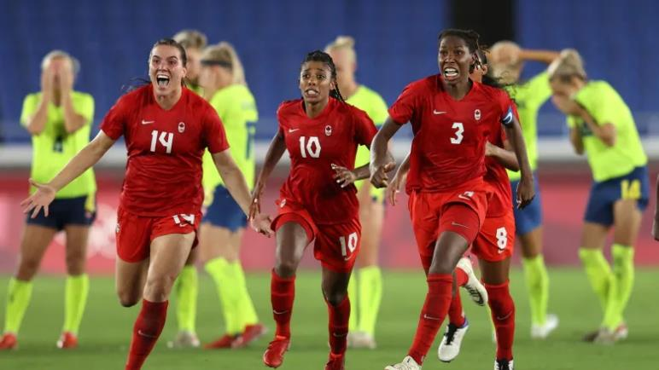
Notes:
Key questions:
What does the image show?
How does it make you feel?
How would you describe the meaning of the image?
Do you think others could interpret the message differently
Reveal:
“Canadian women's soccer reunites for Celebration Tour as squad begins looking ahead”
https://www.cbc.ca/sports/soccer/canada-womens-soccer-celebration-tour-1.6220470

Slide 4
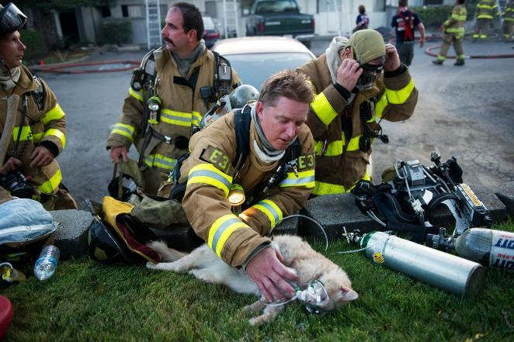
Notes:
Key questions:
What does the image show?
How does it make you feel?
How would you describe the meaning of the image?
Do you think others could interpret the message differently
Reveal:
Stock image of firefighter providing oxygen to a cat.

Slide 5
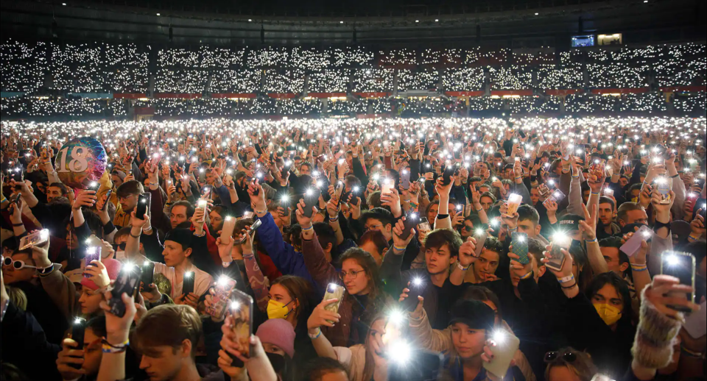
Notes:
Key questions:
What does the image show?
How does it make you feel?
How would you describe the meaning of the image?
Do you think others could interpret the message differently
Reveal:
People used their smartphones to light up a stadium in Vienna, Austria, during the We Stand With Ukraine charity concert on March 19. All of the money made from ticket sales went to humanitarian aid for the country. More than four million people have fled Ukraine since Russia invaded in February. Keep scrolling for more of the best photos from around the world. (Image credit: Florian Wieser/APA/AFP via Getty Images)
Source: https://www.cbc.ca/kidsnews/post/best-photos-from-around-the-world

Slide 6
Activities — Example Images

Slide 7
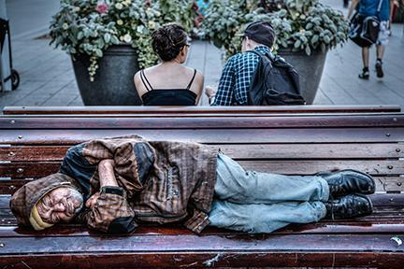
Walk-through Demonstration
Notes:
Think Aloud Sample script:
What does the image show? “I see an older man lying on a park bench with his eyes closed. His clothes are disheveled and dirty looking, and his skin looks unwashed. Facing away from him on the other side of the bench are two younger people who seem to be talking to one another. They are well-dressed and cleanly groomed.”
How would you describe the meaning of the image? “I think this man doesn’t have a home and is trying to find a place to sleep. The two people sitting on the other side of the bench appear to be unaware of his presence or are ignoring him. The way they are positioned suggests that they are indifferent or don’t care about this poor individual living on the streets.”
Do you think others could interpret the message differently? If so, what other meanings can you think of? “There are many cities in the world that try to prevent unhoused people from sleeping on benches by deliberately designing them to be uncomfortable. This photo could illustrate a more open attitude to allowing people to sleep where they choose. ”

Slide 8
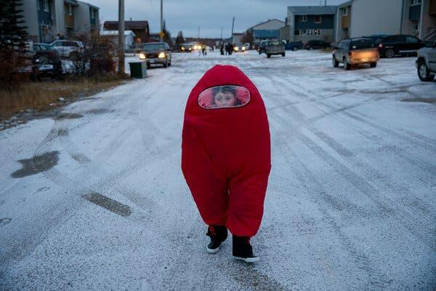
Notes:
Original source of photo:
https://www.nytimes.com/2021/11/04/opinion/arctic-climate-change-canada.html
From New York Times ‘What’s Going On In This Picture?’ series:
https://www.nytimes.com/2021/11/14/learning/whats-going-on-in-this-picture-nov-15-2021.html

Slide 9
Jasper Hunter on Halloween in Churchill. Townspeople drive behind trick-or-treaters to protect them from polar bear attacks, a real danger. From The New York Times, Nov 4, 2021
Notes:
Original source of photo:
https://www.nytimes.com/2021/11/04/opinion/arctic-climate-change-canada.html
From New York Times ‘What’s Going On In This Picture?’ series:
https://www.nytimes.com/2021/11/14/learning/whats-going-on-in-this-picture-nov-15-2021.html

Slide 10
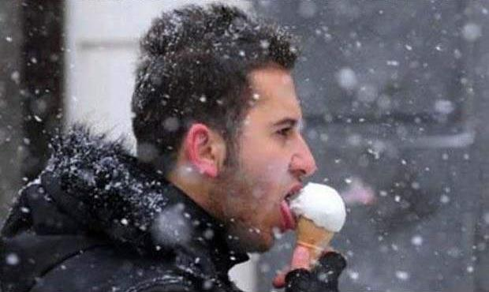

Slide 11
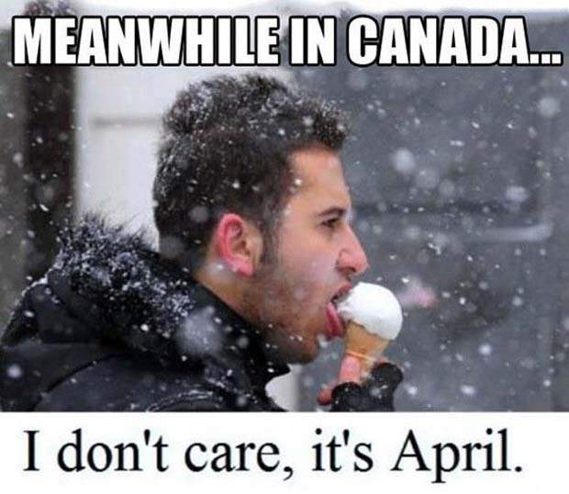

Slide 12
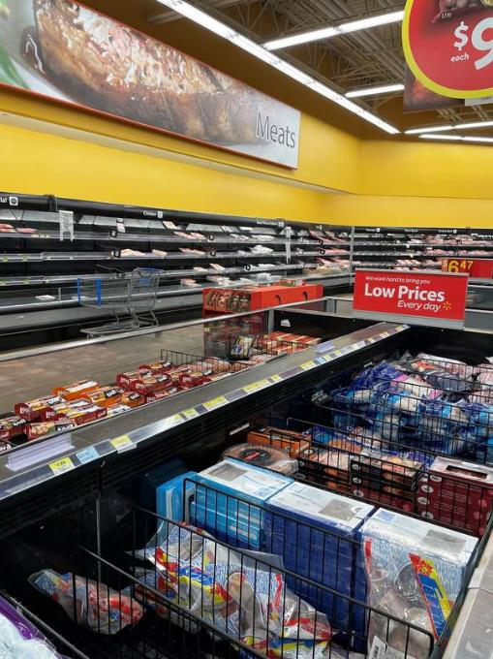
Notes:
https://www.thestar.com/business/2022/01/25/customers-are-reporting-bare-shelves-and-product-shortages-at-grocery-stores-but-retailers-say-there-is-no-food-shortage-yet.html

Slide 13
Notes:
https://www.thestar.com/business/2022/01/25/customers-are-reporting-bare-shelves-and-product-shortages-at-grocery-stores-but-retailers-say-there-is-no-food-shortage-yet.html

Slide 14
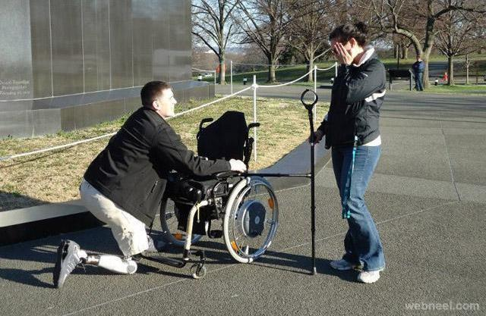

Slide 15
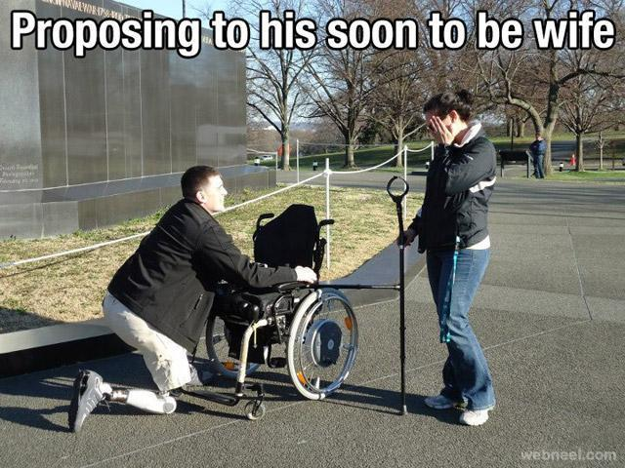

Slide 16
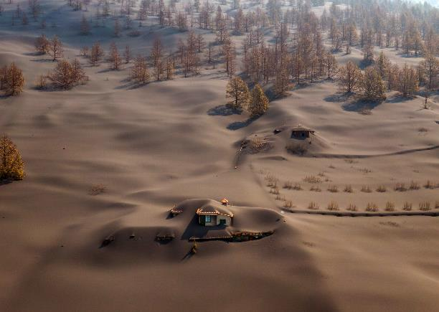
Notes:
https://www.theguardian.com/artanddesign/gallery/2021/nov/05/twenty-photographs-of-the-week

Slide 17
La Palma, Spain. A house is covered by ash from a volcano as it continues to erupt on the Canary island. Nov 5, 2021
Notes:
https://www.theguardian.com/artanddesign/gallery/2021/nov/05/twenty-photographs-of-the-week

Slide 18
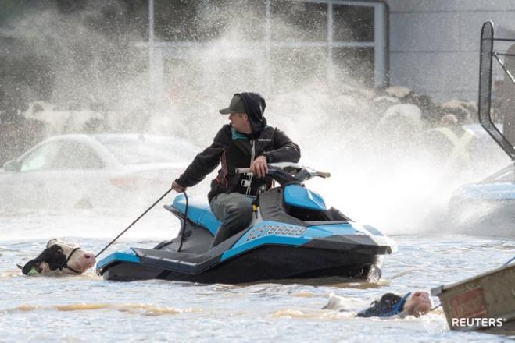
Notes:
https://www.reuters.com/world/americas/canada-province-mulls-state-emergency-after-floods-food-shortages-reported-2021-11-17/

Slide 19
Cows stranded in a flooded barn in Abbotsford, B.C., are rescued by boat following rainstorms that triggered landslides and floods, shutting highways. November 16, 2021.
Notes:
https://www.reuters.com/world/americas/canada-province-mulls-state-emergency-after-floods-food-shortages-reported-2021-11-17/

Slide 20
Different Images, Same Event - Example #1
Guiding question:
How can images influence election campaigns?
The following images were taken during Progressive Conservative Party leader Robert Stanfield’s visit to North Bay, ON in May, 1974 – less than two months away from the federal election.
(Teacher note: Exemplar provided in speaker notes to provide additional context and to help guide the discussion).
Notes:
https://docs.google.com/document/d/1-2iREWfJoqpsCoMasuGpXV0KKbE2_-au1uAJjLO6QjI/edit

Slide 21
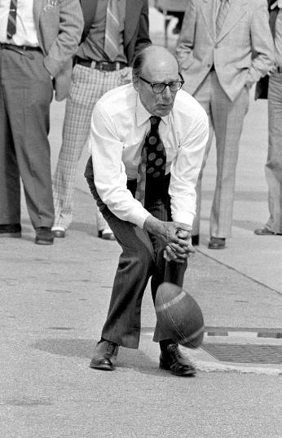
Progressive Conservative Party leader,
Robert Stanfield,
May 30, 1974
Notes:
https://docs.google.com/document/d/1-2iREWfJoqpsCoMasuGpXV0KKbE2_-au1uAJjLO6QjI/edit

Slide 22
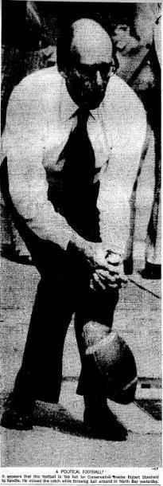
Newspaper Caption:
“A POLITICAL FOOTBALL?
It appears that this football is too hot for Conservative leader Robert Stanfield to handle. He missed the catch while throwing ball around in North Bay yesterday”
Source:
The Globe and Mail, May 31, 1974, A1 (Front page)
Notes:
https://docs.google.com/document/d/1-2iREWfJoqpsCoMasuGpXV0KKbE2_-au1uAJjLO6QjI/edit

Slide 23
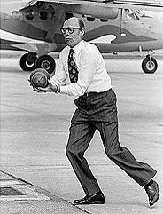
Unpublished photo from the same day

Slide 24
Different Images, Same Event - Example #2
The following images are part of a set. They represent different interpretations of a photo taken during Prime Minister Justin Trudeau’s first visit to meet American President Donald Trump in February 2017.
These examples provide an opportunity to discuss how images can be remixed online or how different captions/headlines can encourage the viewer to interpret the image differently.

Slide 25
Different Images, Same Event - Example #2
Guiding questions:
How can images be reused?
How can different captions/headlines influence the viewer’s interpretation of an event?
The following set of images represent different interpretations of a photo taken during Prime Minister Justin Trudeau’s first visit to meet American President Donald Trump in February 2017.

Slide 26
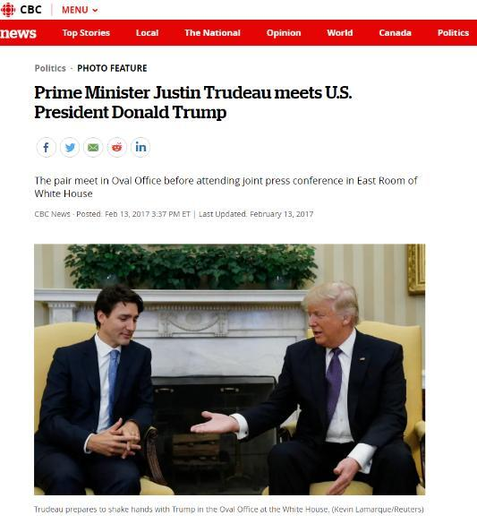

Slide 27
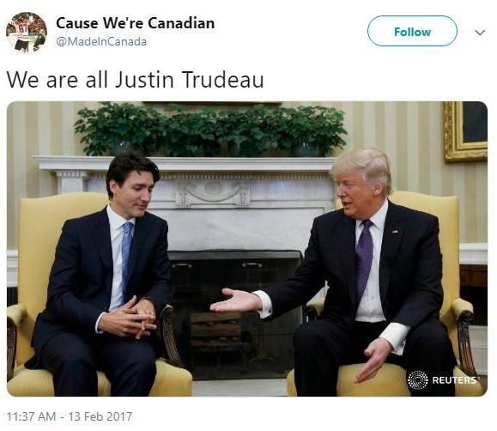

Slide 28
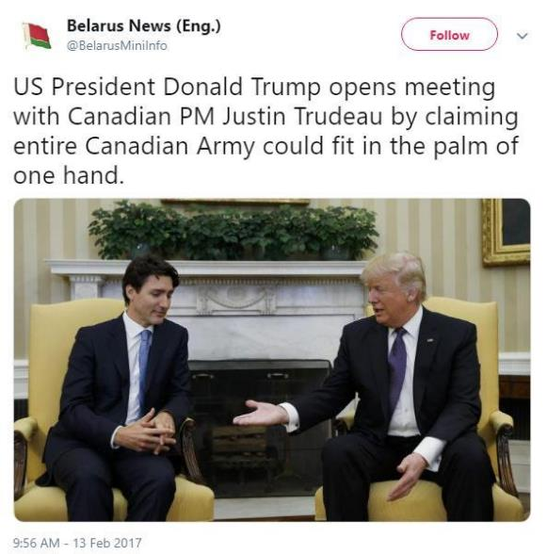

Slide 29
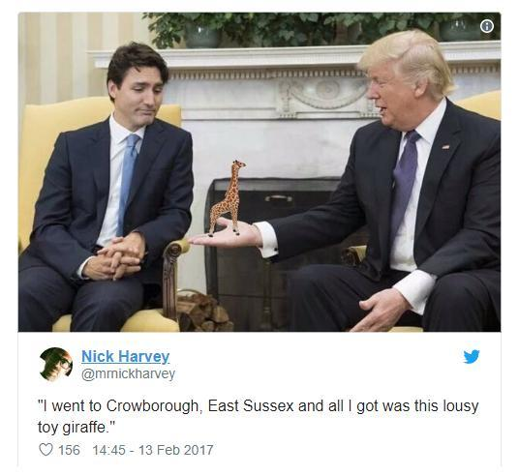

Slide 30
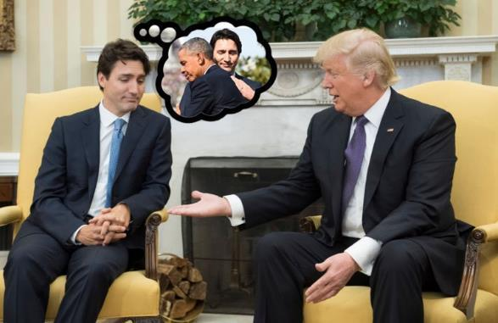

Slide 31
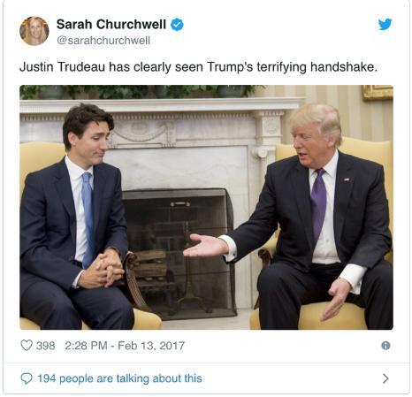

Slide 32
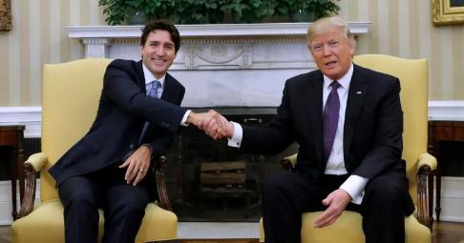
Source: https://nationalpost.com/news/politics/trudeau-trump

Slide 33
Different Images, Same Event - Example #3
Guiding questions:
How do media organizations use images to to tell stories?
How do different media organization portray the same event?
The following photos were published alongside different articles on ‘Freedom Convoy’ protests in Ottawa during February 2022.

Slide 34
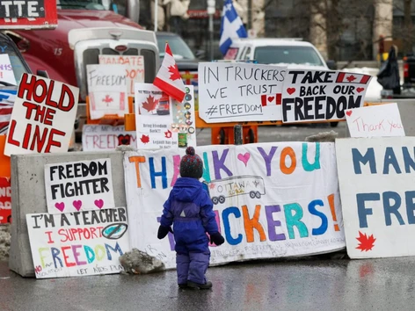

Slide 35
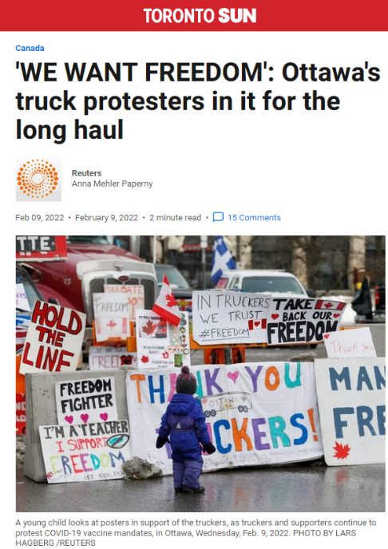
Notes:
https://torontosun.com/news/national/we-want-freedom-ottawas-truck-protesters-in-it-for-the-long-haul

Slide 36
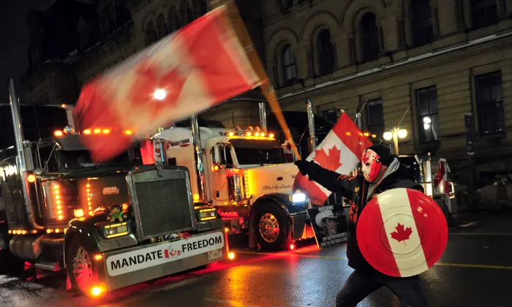

Slide 37
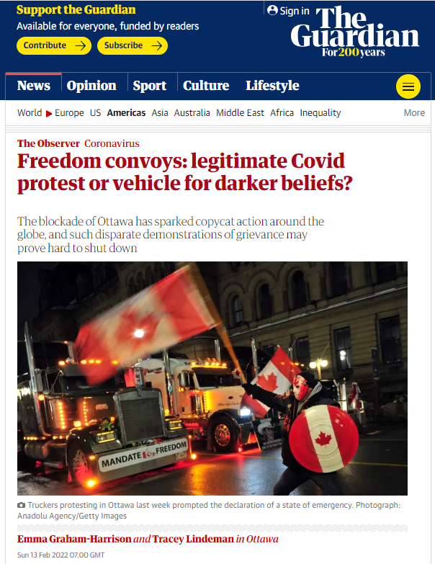
Notes:
https://www.theguardian.com/world/2022/feb/13/freedom-convoys-legitimate-covid-protest-or-vehicle-for-darker-beliefs

Slide 38
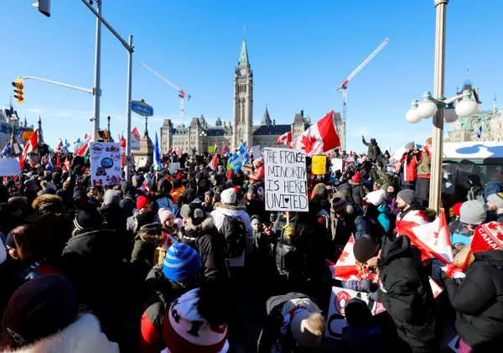

Slide 39
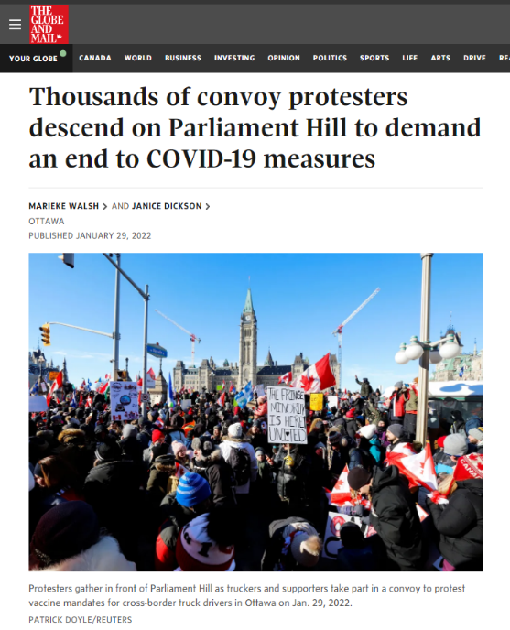
Notes:
https://www.theglobeandmail.com/politics/article-thousands-of-convoy-protesters-descend-on-parliament-hill-to-demand-an/

